Slide 1

Analysis of Mobile Phone Call Data
Presented by B.Srinu
Batch-7230

Slide 2
Objective
The Main objective of this project is to determine the call log data of Mobile Phone

Slide 3
Abstract
Mobile phones have become Popular in a very short time.
Almost 5 Billion Users are using the Mobile Phones all over the World.
Here we present a scheme which uses analysis of a typical mobile feature phone call data to yield interesting and useful results which would enable determination of some of the mobile user characteristics and enable possible productivity improvements.

Slide 4
ELEMENTARY CALL LOG DATA ANALYSIS
The elementary data analysis describes the simple statistics on a single data set
The phone call data in mobile phones. For example, consider the voice call history consisting of elementary data such as
(a) phone numbers of incoming, dialed, and missed calls
(b)The days, times, and durations of incoming and dialed calls. Using elementary data analysis on the above data, one can derive various distributions related to calls.

Slide 5
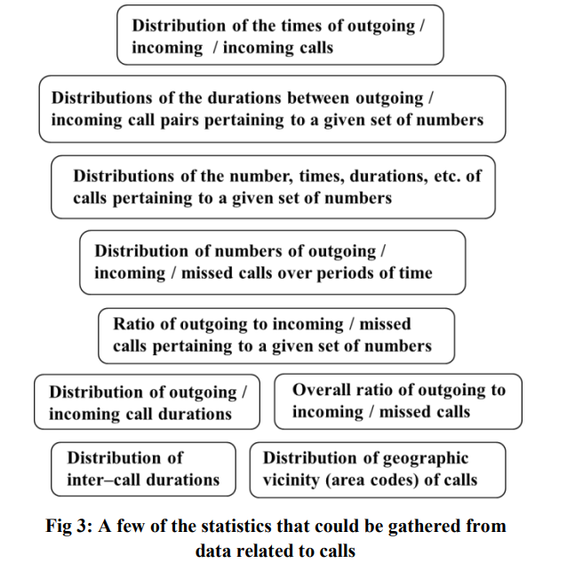

Slide 6
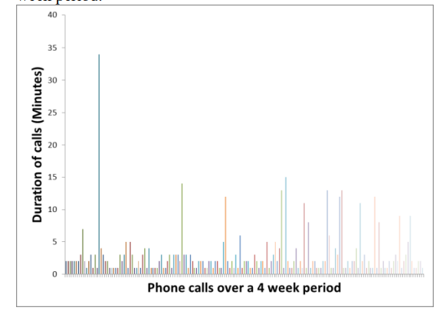
Aggregate of phone calls over a 4-week period
Observation: The distributions of phone call durations are bursty – the calls are mostly of short durations, and once in a while there are high peaks corresponding to calls of long durations.

Slide 7
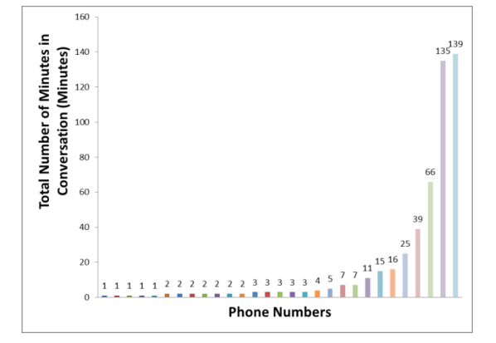
Call durations across phone numbers
Observation: There is a very small percentage of phone calls with long durations – corresponding to known persons with close relationship and relatively long tail of short call durations.

Slide 8
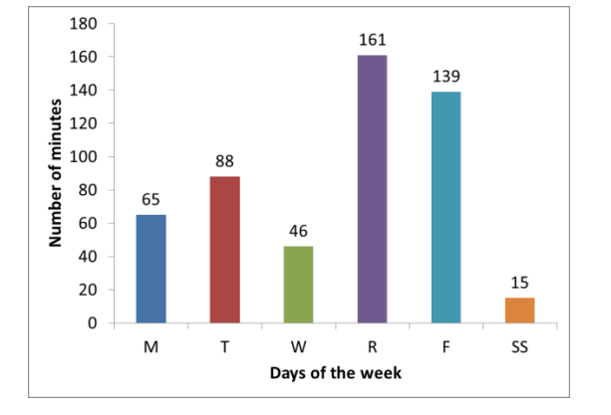
Distribution of call durations over weekdays and weekends
Observations: The week starts off slowly with respect to the total duration of calls on Monday. It has high peaks on Thursday and Friday. The time spent on weekends is very minimal. Time spent talking on Wednesday is the lowest among weekdays – a very likely reason being the user involved in part-time work or some serious activity on that day. 4.4 Distribution of call durations across all day.

Slide 9
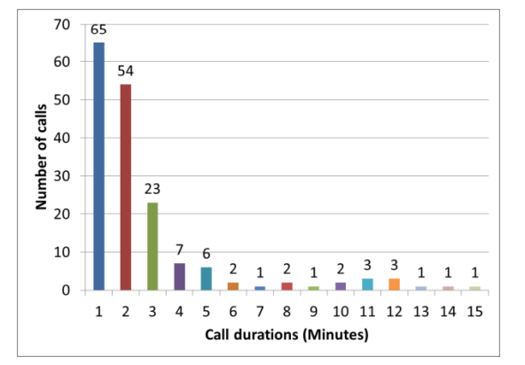
Distribution of call durations across all calls
Observations: The number of calls of short durations are very high (for 1 – 2 minutes) and tapers off rapidly for durations of 3 minutes and above.

Slide 10
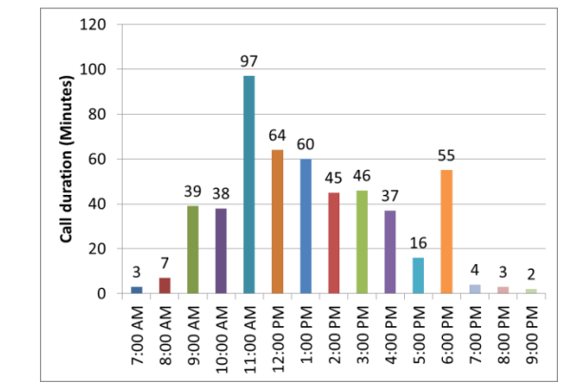
Distribution of call durations at different times of the day
Observations: The call activity starts about 7 am. It ramps up and peaks between 11:00 am and noon. Generally there is high activity between 9 am and 5 pm, and between 6pm and 7 pm. Between 5pm and 6 pm there is lesser activity.

Slide 11


